Slide 1

Targeting Immune Checkpoint Therapy Resistance with Novel MSC-Engineered Extracellular Vesicles
Yves Greatti
April 29, 2024
Notes:
Today I introduce my project which consists in designing a novel cancer drug using Mesenchymal Stem Cell-derived Extracellular Vesicles or EVs.

Slide 2
Significance

Slide 3
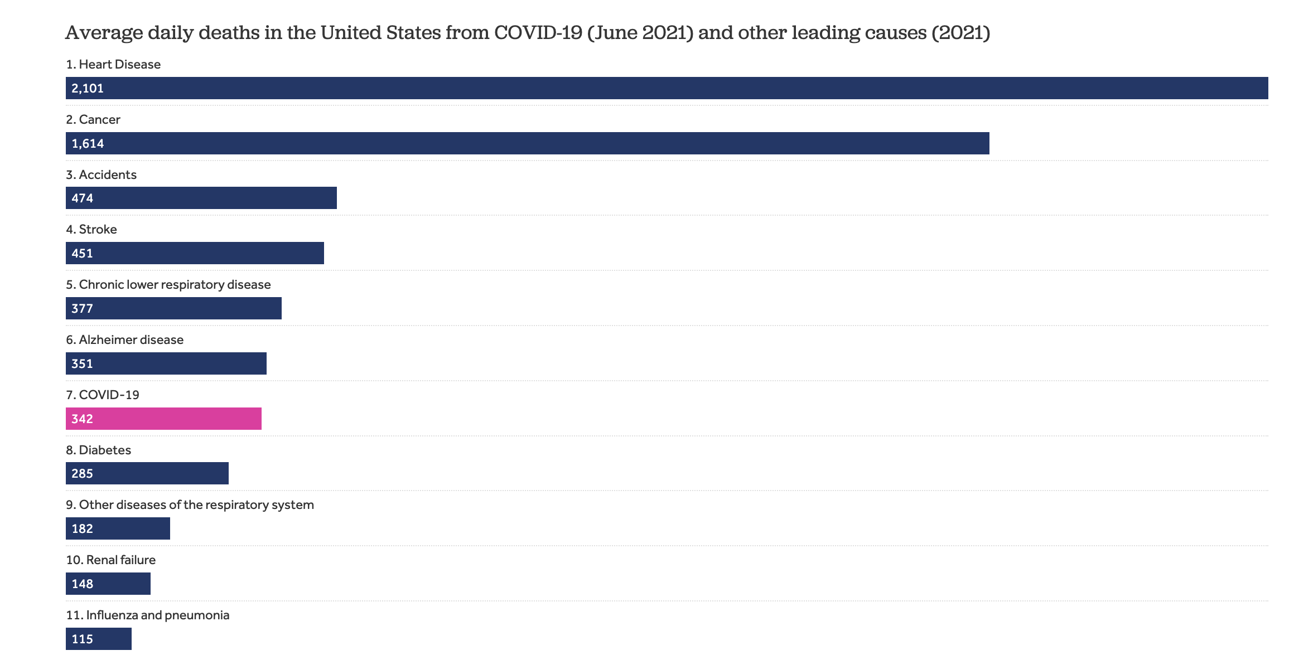
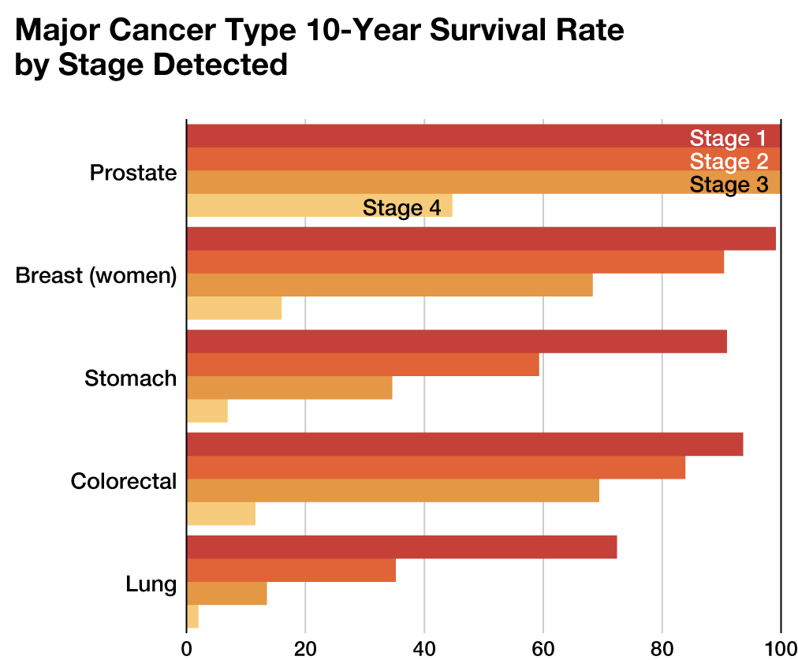
The Persistent Challenge of Cancer Today
2024-cancer-facts-and-figures-acs
Notes:
Economic and health impacts of cancer are major.

Slide 4
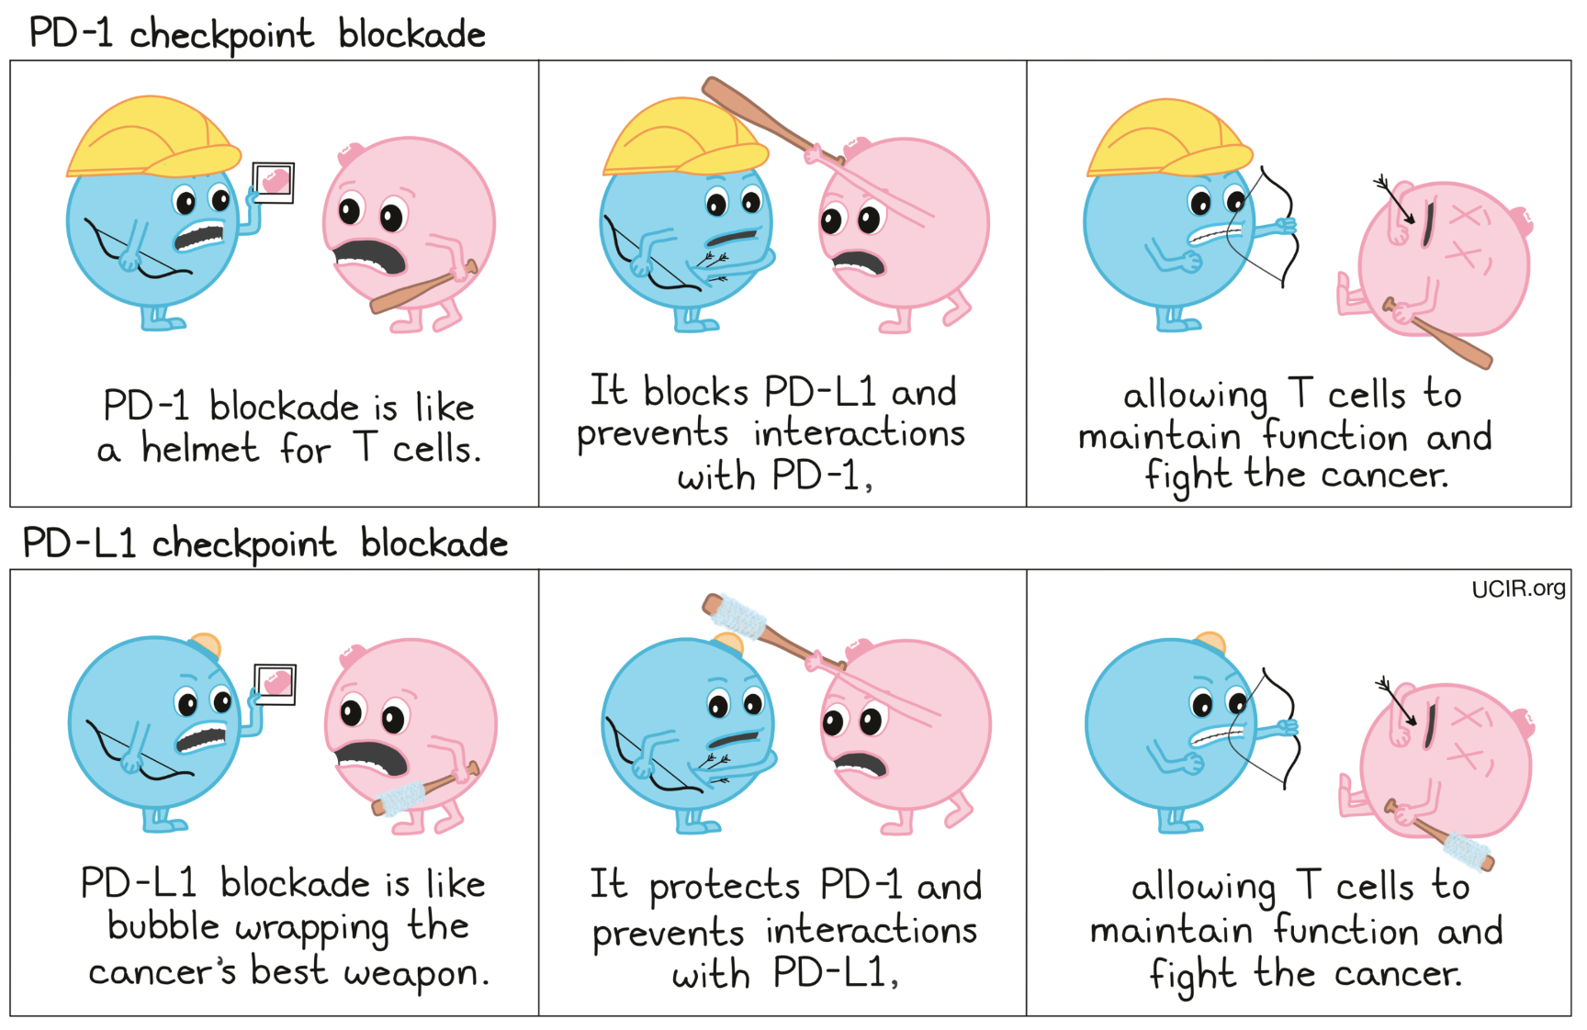
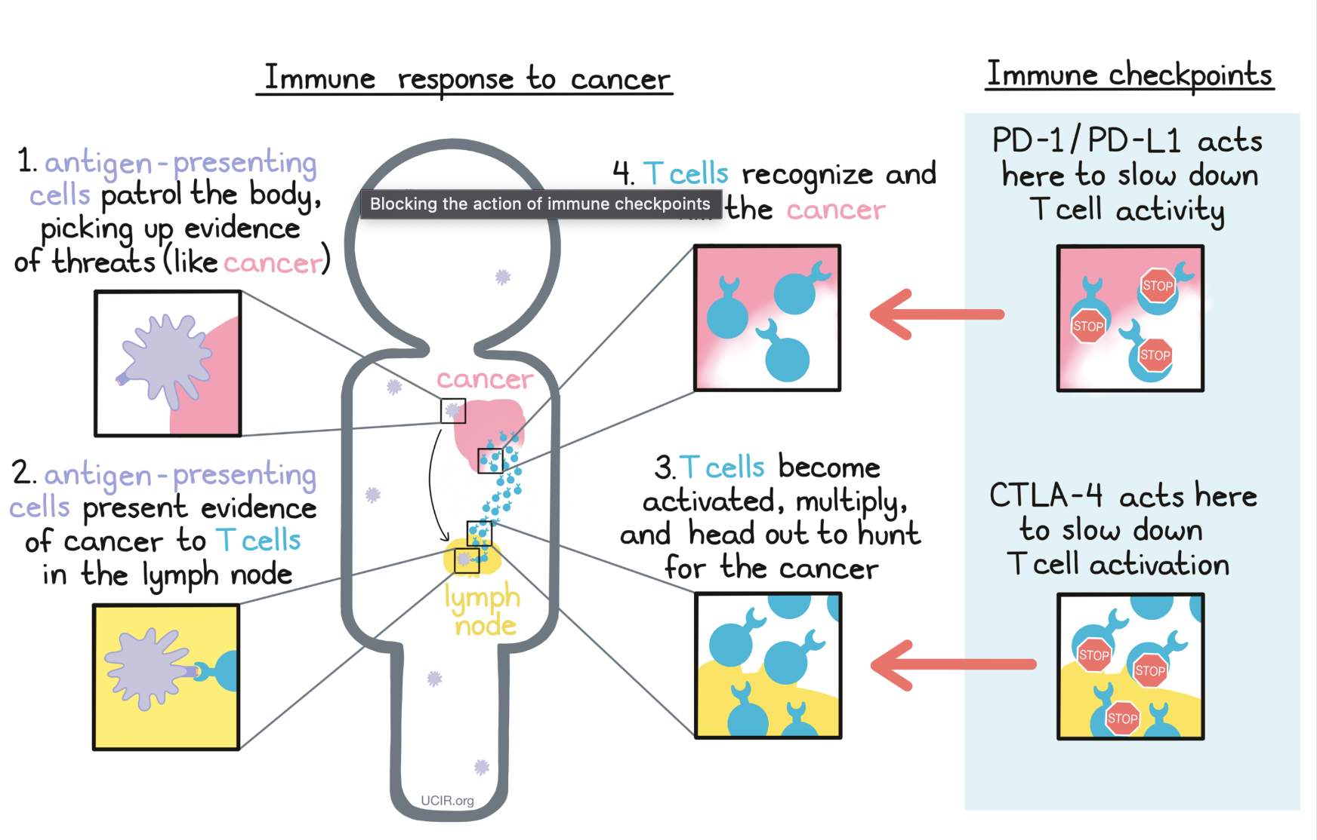
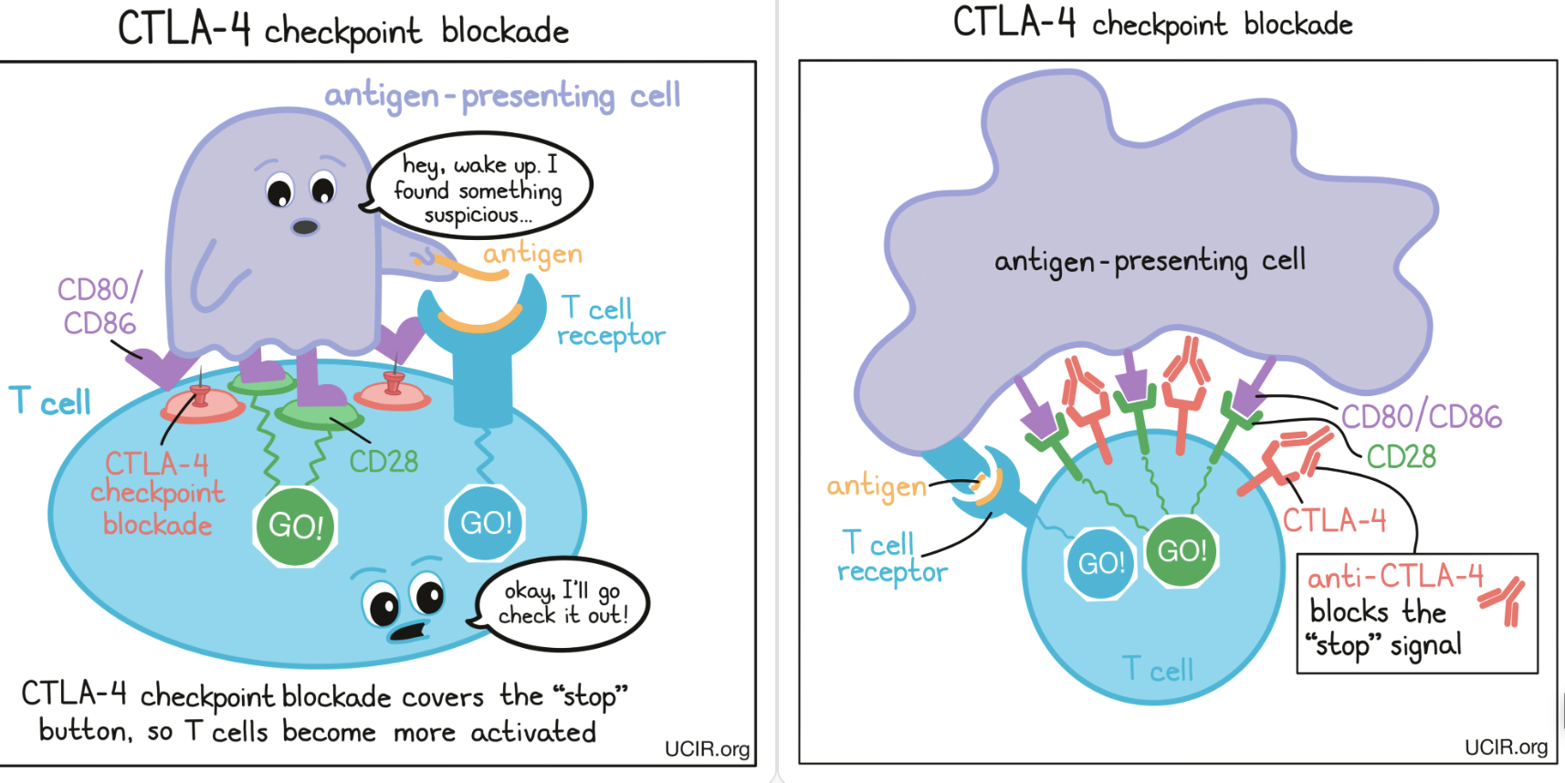
Immune Checkpoint Blockade Therapy
Notes:
What are the stages of immune response to cancer?
In a healthy immune response, CTLA-4 functions as a brake on T cells to prevent overactivation
Tumors can create an immunosuppressive microenvironment that encourages the expression of CTLA-4.
Anti-CTLA-4 therapies are designed so that they specifically bind to CTLA-4 on the surface of the T cells. This binding prevents CTLA-4 from interacting with B7 molecules on APCs.
By blocking CTLA-4, the therapies ensure that T cell activation is restored.
Now, PD-1 is a receptor found on the surface of T cells. Its ligands, PD-L1 and PD-L2, can be expressed on the surface of various cells, including tumor cells.
Many types of cancer upregulate PD-L1, "instructing" T cells to turn off and allowing the tumor to escape immune detection and destruction.
PD1-/PD-L1 immunotherapies, can either bind to PD-1 on T cells, or directly bind to PD-L1 on tumor cells, blocking their ability to send inhibitory signals to T cells.

Slide 5
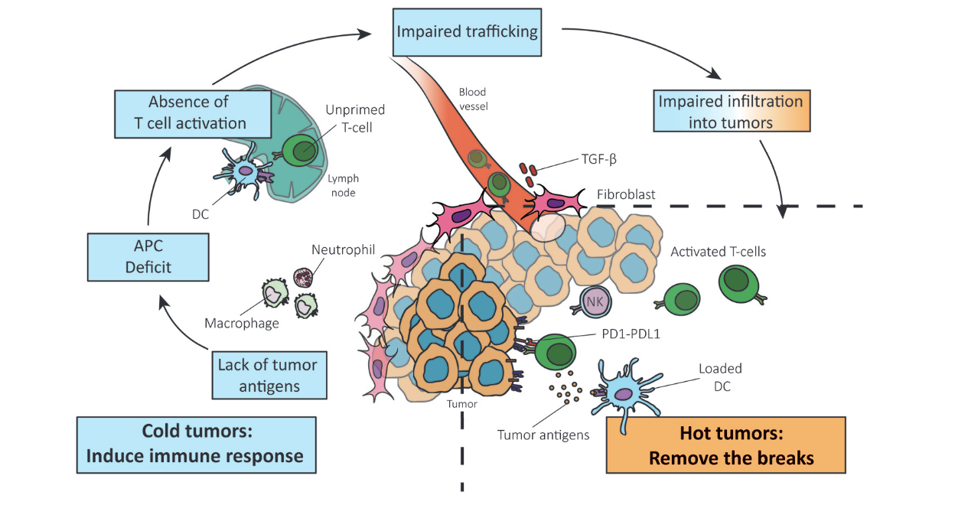
Reversing a Cold Tumor Into a Hot Tumor
Notes:
Challenges posed by cold tumors in cancer treatment.
In "hot" tumors, the main challenge is overcoming the inhibition of the immune response that is induced by the cancer cells.
Recent immunotherapies have seen substantial success in treating "hot" tumors but have been far less effective for "cold" tumors.
In the early stages, cancer is able to evade the immune system by not presenting significant neoantigens.
The second stage of immune response to the tumor involves the presentation of these tumor antigens by dendritic cells (DCs), which leads to the priming and activation of T cells that can attack the cancer.
However, when there is a lack of tumor antigen, this results in a deficiency in the recruitment of antigen presenting cells (APCs).
This, in turn, leads to a lack of co-stimulation and activation of T cells.
Moreover, altered production of chemokines and cytokines, that mediate immune responses, can affect cell trafficking and activation.
This impaired trafficking and infiltration is typically characterized by the exclusion of CD8+ T cells by the stroma of the tumor.
The stroma environment prevents T cells from reaching the cancer cells.

Slide 6
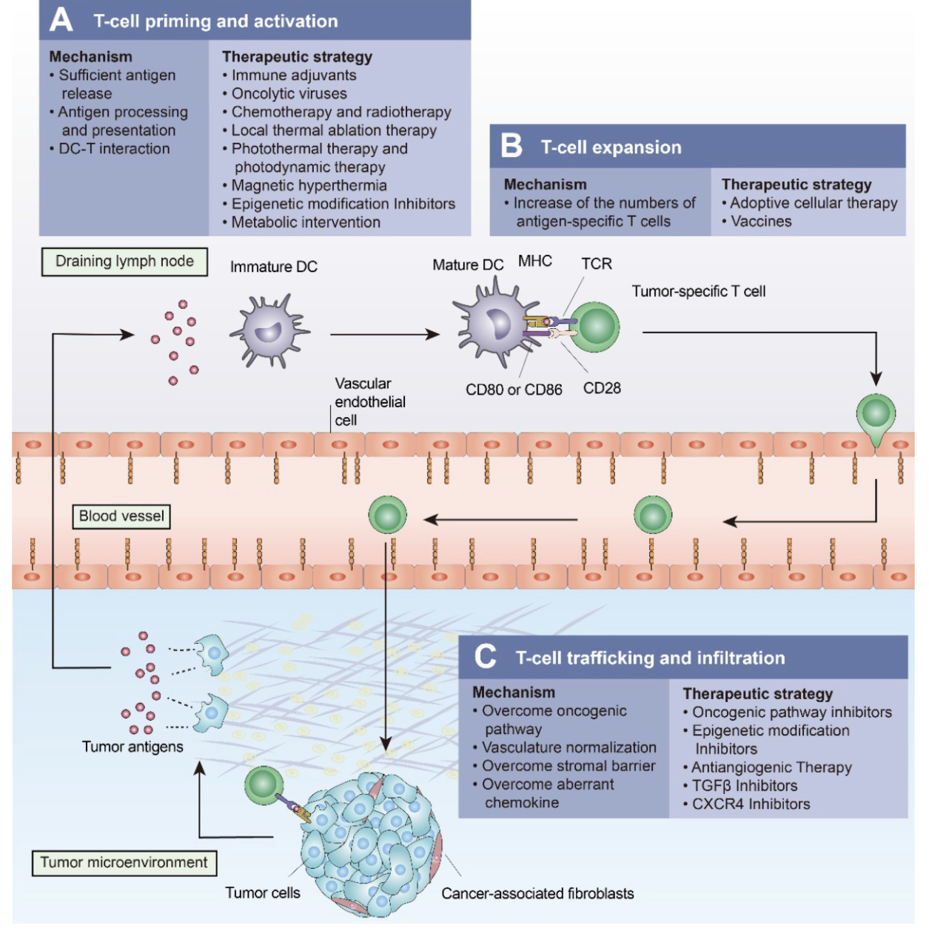
Strategies to Overcome the Challenges Presented by “Cold” Tumors
Proposed
Therapeutic Agent
Turning cold tumors into hot tumors by improving T cell infiltration
Yuan-Tong Liu, Zhi-Jun Sun doi: 10.7150/thno.58390
Notes:
Some strategies are illustrated here to improve the efficacy of
immune checkpoint Therapies :
Oncolytic viruses, Chemotherapy and radiotherapy are capable of inducing immunogenic cell death to promote T-cell priming and activation.
Local administration of immune adjuvants such as TLR agonists promotes the activation of dendritic cells.
Epigenetic modification inhibitors can promote T-cell priming by increasing the expression of tumor antigens and by restoring antigen processing and presentation mechanisms.
(B) Cancer vaccines and adoptive cellular therapies, such as CAR-T cells, can promote the expansion of tumor-specific T lymphocytes.
(C) Oncogenic pathway inhibitors, antiangiogenic therapies, TGFβ inhibitors

Slide 7
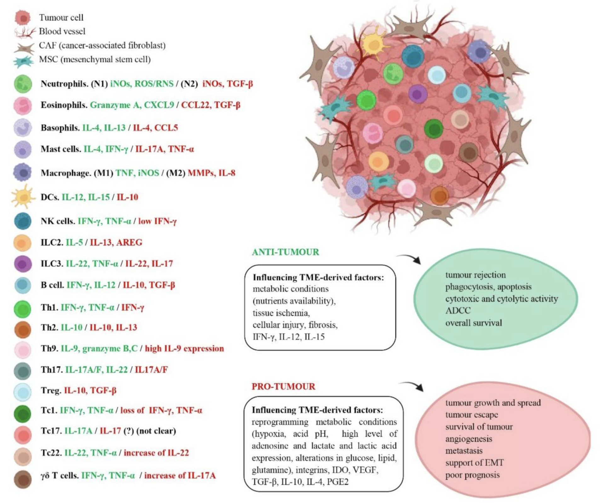
Dual-activities of the Immune System
A. C. Peña-Romero et al., “Dual Effect of Immune Cells within Tumour Microenvironment: Pro- and Anti-Tumour Effects and Their Triggers
Notes:
Immune cells can behave as guardians (anti-tumour immunity) or as supporters of the tumour (pro-tumour immunity) which makes them a “double-edged sword” in the TME.
On the left, the cytokines secreted by the different types of immune cells are shown.
Those released in anti-tumour activity are shown in green and those released in pro-tumour activity in red, and in some cases the same cytokine has dual effect.
On the other hand, on the right, you find TME-derived factors, which influence immune cell fate, and their outcomes, accordingly, are shown, both in an anti-tumour and pro-tumour microenvironment

Slide 8
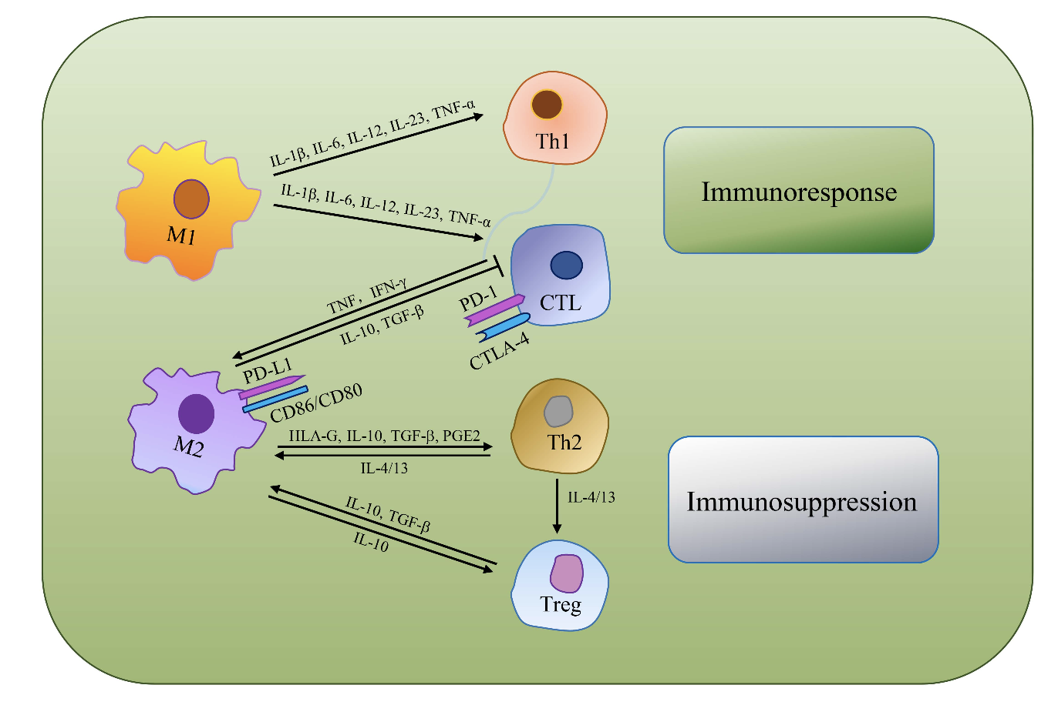
Tumor Associated Macrophages (TAMs)
TAMs as the most dominant immune cell type, are an indispensable target for immunologically cold tumor
Tong et al., “Tumor Associated Macrophages, as the Dominant Immune Cells, Are an Indispensable Target for Immunologically Cold Tumor—Glioma Therapy?”
Notes:
TAMs play a significant role in cancer biology, including influencing tumor growth, angiogenesis, metastasis, and the suppression of antitumor immunity.
M2 macrophages can secrete human leukocyte antigen-G (HLA-G), IL-10, TGF-β, PGE2 and other immunosuppressive molecules, directly inhibiting immune response.
IL-10 plays a negative role in regulating IL-12, which has the capacity to support Th2 cells differentiation, release notable quantities of IL-4 and IL-13
to induce regulatory T cells (Tregs) amplification and direct TAMs development toward a pro-tumor phenotype. Besides, M2 macrophages can suppress CTLs via TGF-β and IL-10 production.

Slide 9
Innovation

Slide 10
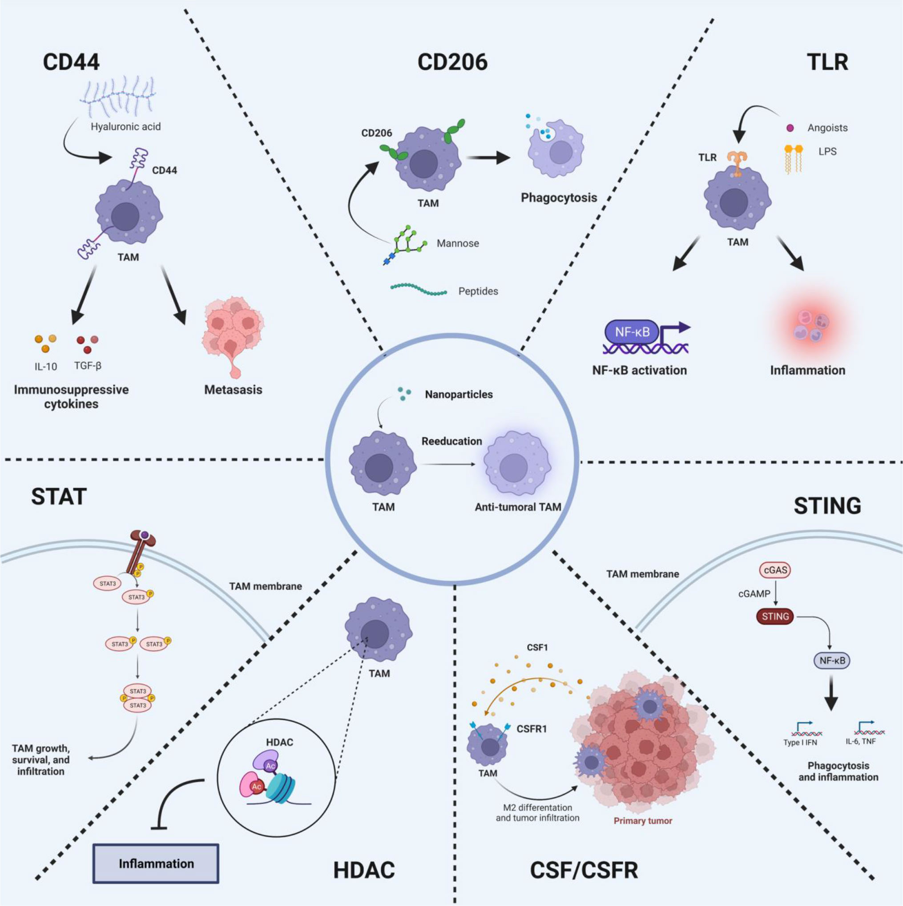
Strategies to reeducate TAMs
X. Shen et al., “TAM-targeted reeducation for enhanced cancer immunotherapy: Mechanism and recent progress,”
Notes:
CD44 is a transmembrane adhesion glycoprotein. Aberrant upregulation of CD44 in tumor cells is closely related to tumor immune escape and invasion.
The JAK-STAT pathway is an inflammatory signaling pathway. STAT signaling is important for macrophage polarization.
This pathway like STING pathway, including CD44 and CD206 have been investigated by targeted therapies.
Two very important pathways in TAM differentiation are:
TLRs are a class of pattern recognition receptors that can detect the substances derived from invading pathogens, which
play essential roles in innate immunity and inflammatory responses.
Colony Stimulating Factor-1(CSF-1), also recognized as colony-stimulating factor (M-CSF), is a cytokine considered a major growth factor regulating the production, differentiation
and function of TAM. CSF-1 is associated with tumor progression, metastasis, angiogenesis, and treatment resistance.

Slide 11
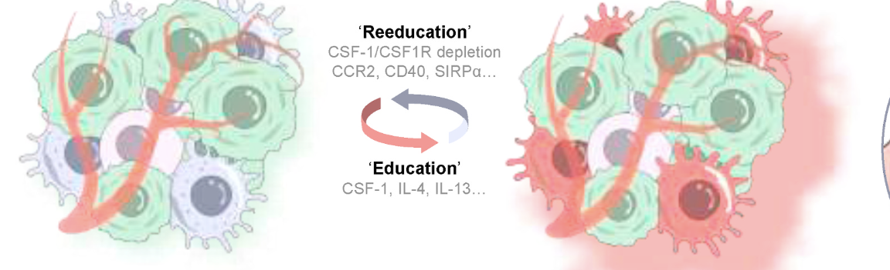
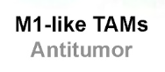
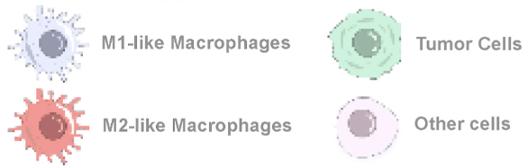
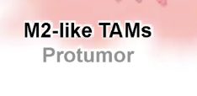
CSF-1/CSF1R Inhibitors modify TAMs behavior within the TME
CSF1R inhibitors are emerging immunotherapeutic drugs for cancer treatment. Jiachen Wen et al.
Notes:
This slide shows the strategic use of CSF-1R inhibitors to modify the behavior of TAMs within the tumor microenvironment.
Macrophages polarize into two subtypes following infiltration to tumor tissue, with M1-like macrophages characterized by biomarkers of CCR7, CD40, CD11c, and M2-like
macrophages by markers of CD169, CD206.
M1-like and M2-like TAMs) ave the capacity transition between each other under stimulation of various cytokines and chemokines termed here as
‘education’ factors and ‘reeducation’ factors.
TAMs express a variety of transmembrane proteins in response to ‘education’ factors, including CSF1R, CCR2, CD40, SIRP1α.

Slide 12
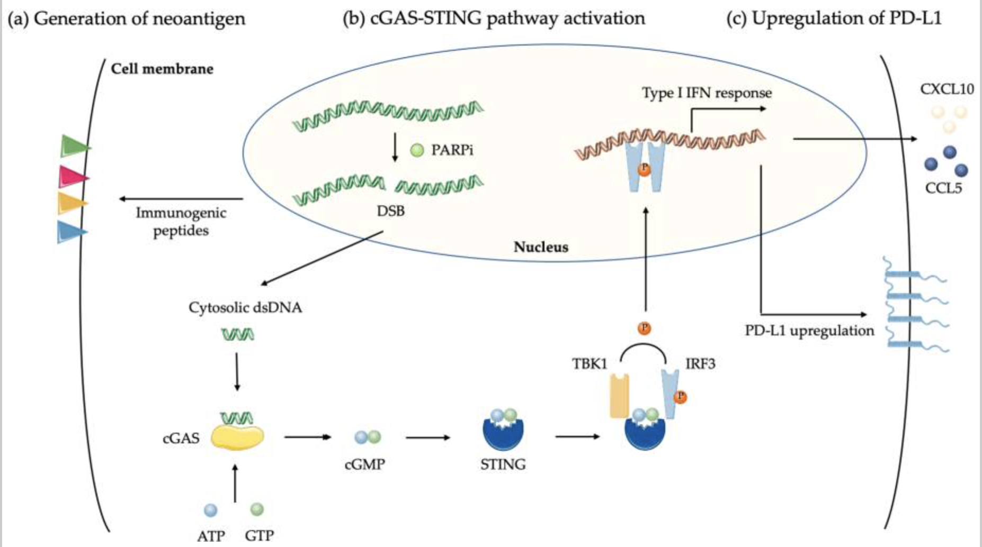
Biological effects of PARP Inhibitor on Cancer Cells
F. Peyraud and A. Italiano, “Combined PARP Inhibition and Immune Checkpoint Therapy in Solid Tumors” .
Notes:
PARP inhibitors (PARPi) operate by delaying the repair of DNA, which results in double-strand breaks (DSB) and severe, unrepairable DNA damage in cancer cells. This increases the load of neoantigens and the tumor mutation burden.
When PARPi induces DSB in tumor cells, it results in the creation of double-strand DNA (dsDNA) fragments. These fragments, when they bind to cyclic GMP-AMP synthase (cGAS), activate the STING pathway. This activation triggers a type of interferon (IFN) response, causing an increase in CCL5 and CXCL10 chemokines that help in the recruitment of T cells.
The STING pathway also triggers an increase in PD-L1, which could have a synergistic effect with an Anti-PD1/PD-L1 ICI therapy.

Slide 13
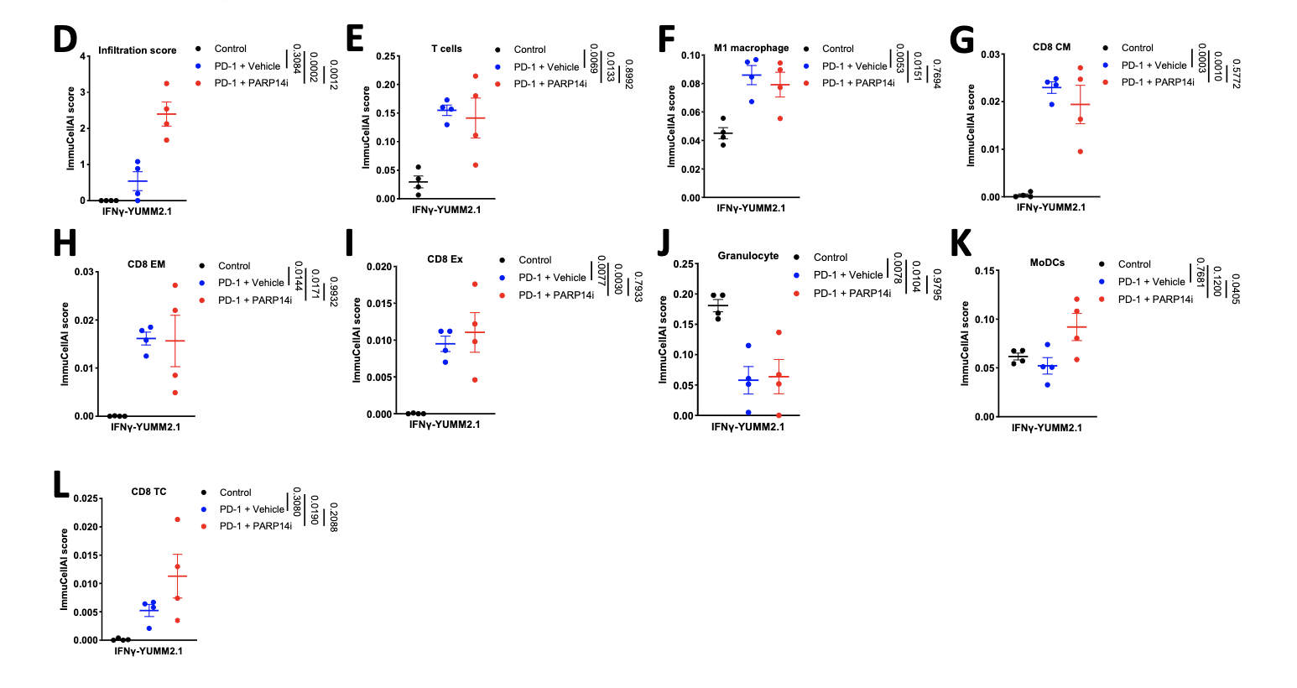
PARP14i Reverses Acquired Resistance to PD-1 Therapy
Effector T cell infiltration is
enhanced in tumors derived from cells pre-treated with IFNγ in immuno-
competent female mice when PARP14 is pharmacologically inhibited or
knocked down, while the presence of regulatory T cells is decreased, leading to
restoration of α-PD-1 sensitivity
C. W. Wong et al., “PARP14 inhibition restores PD-1 immune checkpoint inhibitor response following IFNγ-driven acquired resistance in preclinical cancer models,” Nat. Commun., vol. 14, no. 1, p. 5983, 2023, doi: 10.1038/s41467-023-41737-1
Notes:
D: infiltration, E: T cell, F: M1 macrophage,
G: CD8 central memory (CM) T cells, H: CD8 effector memory (EM) T cells,
I: exhausted (Ex) CD8 T cells, J: Granulocytes, K: Myeloid Dendritic cell (MoDC),
L: CD8 cytotoxic T cell (Tc).

Slide 14
Research Strategy

Slide 15
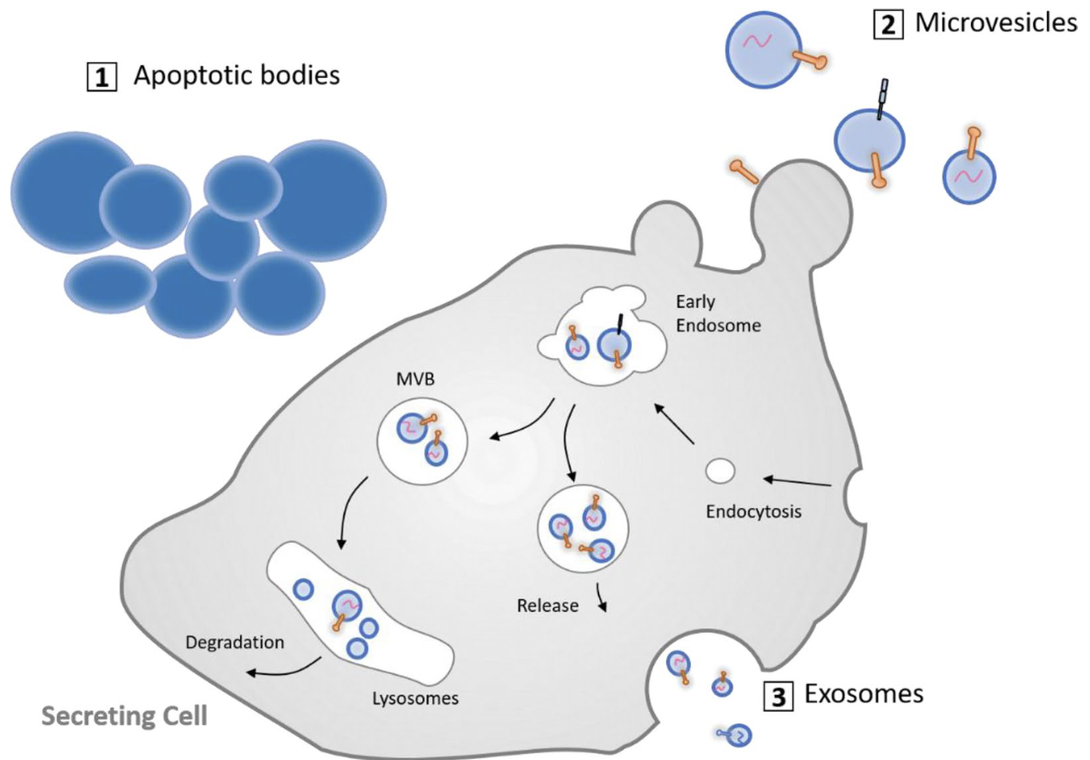
Therapeutic Potential of Mesenchymal Stem Cell-Derived Extracellular Vesicles
MSCs are favored as sources of EVs due to:
Ability to modulate the immune response
Promote tissue repair and regeneration
Low immunogenicity
Engineering flexibility
Scalable production
Notes:
Exosomes
Size: Typically 30-100 nm in diameter.
Features: Exosomes are rich in nucleic acids, proteins, and lipids. They naturally encapsulate these molecules, making them excellent carriers for small molecule drugs, RNA, or other therapeutic agents.
Usage: Due to their small size and composition, exosomes can cross biological barriers such as the blood-brain barrier, making them ideal for targeting drugs to specific sites, including the brain.
Microvesicles
Size: Typically larger than exosomes, ranging from 100 to 1000 nm in diameter.
Features: Microvesicles carry a variety of biomolecules, including proteins and lipids, and also encapsulate nucleic acids and cytosolic components.

Slide 16
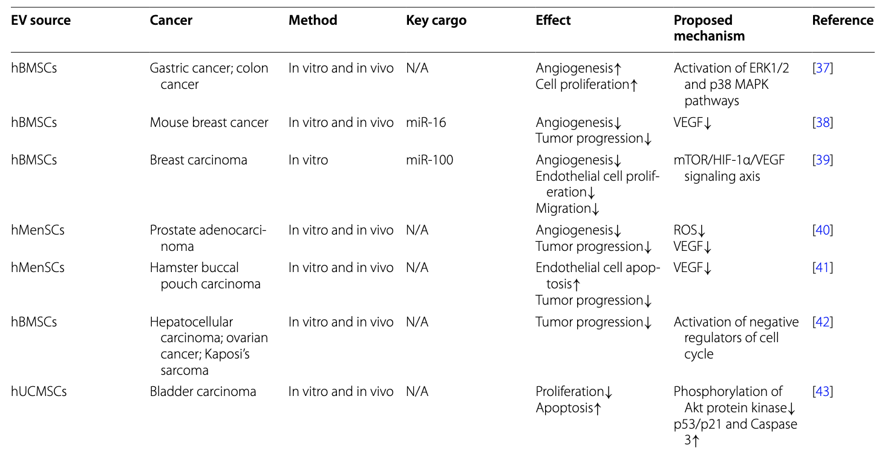
Effects of MSC-derived EVs on Different Types of Cancers
iPSC-MSC-EV Advantages
Anti-Inflammatory Bioactivity
Scalability
Donor Availability
Could induce M2-like transition
Z. Weng et al., “Therapeutic roles of mesenchymal stem cell-derived extracellular vesicles in cancer,” J. Hematol. Oncol., vol. 14, no. 1, p. 136, 2021, doi: 10.1186/s13045-021-01141-y

Slide 17
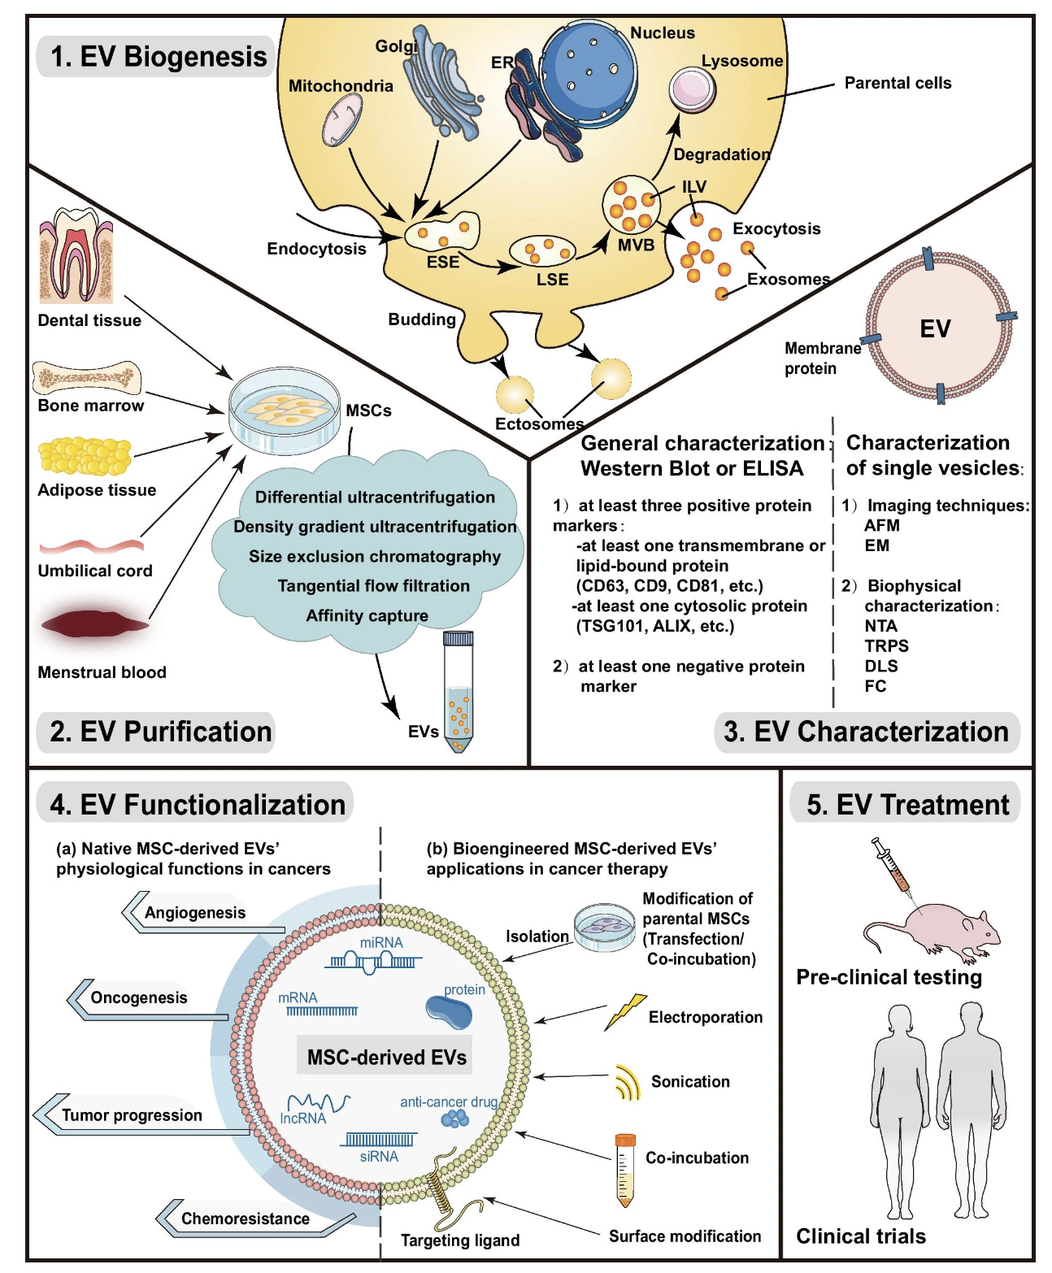
Key steps in the process of Engineering MSC-derived EVs’ Therapeutic Applications
There are well-established and reliable methods for engineering MSC-derived EVs
Z. Weng et al., “Therapeutic roles of mesenchymal stem cell-derived extracellular vesicles in cancer,” J. Hematol. Oncol., vol. 14, no. 1, p. 136, 2021, doi: 10.1186/s13045-021-01141-y

Slide 18
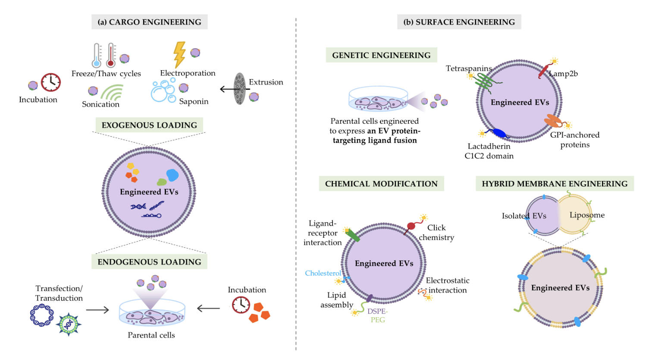
Strategies to maximize the therapeutic efficacy of EVs
Click Chemistry: Ideal for attaching small molecules to exosomes due to its high specificity and yield.
Lipid Anchoring: Small molecule agonists or inhibitors can be modified to include lipid tails, facilitating their integration into the exosome lipid bilayer.
Nanocarrier Encapsulation: Encapsulate the drug within exosomes to protect the active agents from degradation and ensure targeted delivery.
Cristiana Ulpiano et al., “Bioengineered Mesenchymal-Stromal-Cell-Derived Extracellular Vesicles as an Improved Drug Delivery System:Methods and Applications

Slide 19
Methodology for the design of the MSC-derived EV Therapeutic Agent
1. Enrich the M1 population of tumor-associated macrophages (TAMs) and modulate TAM recruitment and distribution.
Approach: Utilize chemical conjugation techniques to attach R848 to the exosome surface.
2. Create dual-targeting exosomes that selectively target TAMs while evading the immune system via CD47 expression, which signals "don't eat me" to phagocytes.
Approach: Combine CD47 Expression with TAM-Specific Ligands.
Introduce vectors encoding CD47 into cell cultures that will be used to harvest exosomes. Use covalent attachment to attach antibodies against M2-like TAM marker CD80 to the exosome surface.
3. Ensure that exosomes are sufficiently expressing CD47 to avoid uptake macrophages and dendritic cells of the MPS without impairing the ability to target specific cells at the tumor site.
Approach: optimize the level of CD47 expression on exosomes using a promoter with adjustable strength to find the right balance where exosomes can evade phagocytosis without completely inhibiting macrophage interaction where needed.
4. Modify the R848 molecule for pH-sensitive release near the cancer cells.
Approach: Synthesize a peptide linker that is sensitive to the acidic pH typical of tumor environments. This peptide should include a sequence specific to the matrix metalloproteinase-2 (MMP-2), which is often overexpressed in tumor tissues.
Notes:
The peptide linker will be synthesized such that one end has a functional for attachment to R848, and the other end can be conjugated to the exosome surface or another suitable carrier.
Integrate a sequence that is specifically recognized and cleaved by MMP-2. MMP-2 recognizes and cleaves peptides containing a specific sequence of amino acids. For example, a commonly used sequence for MMP-2 sensitivity is 'GPLGVRG’.
Once the peptide-linked R848 is localized near the tumor cells (where MMP-2 expression is high), MMP-2 enzymes will cleave the peptide at the specific recognition site ('GPLGVRG’).
This cleavage releases R848 in an active form precisely at the site where MMP-2 is overexpressed.

Slide 20
Testing and Validation

Slide 21
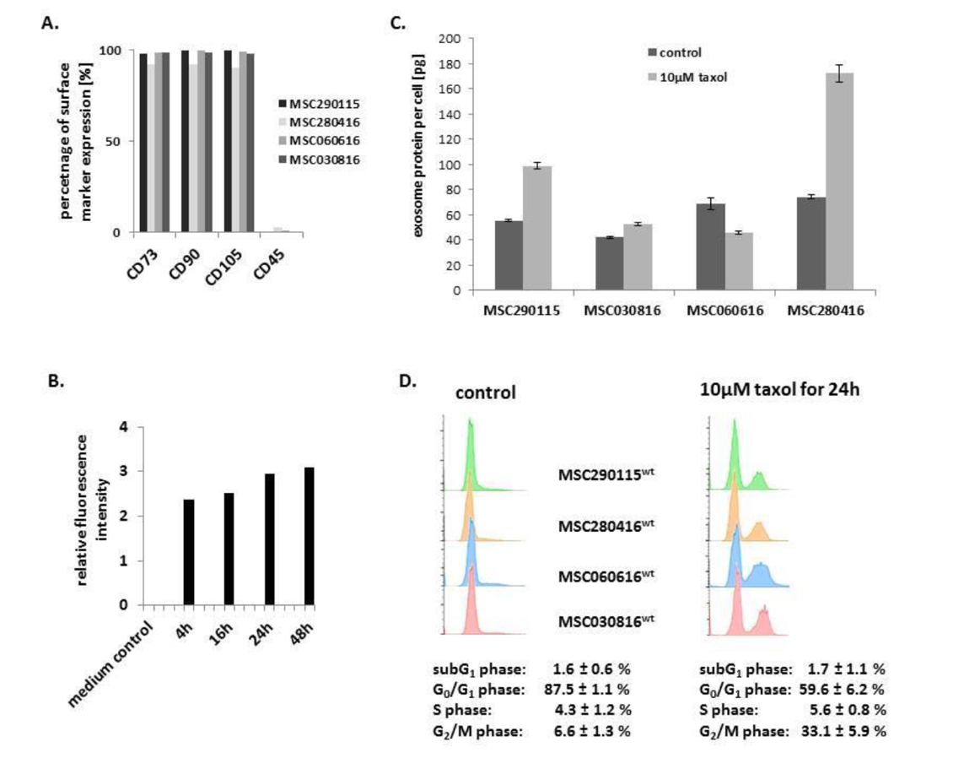
Assessment of Cytotoxic Effects of Engineered Exosomes Produced by MSCs
A) Characterization of four different MSC investigated populations.
B) Kinetic of exosomes production by MSC^{GFP}: progressive exosome release increase to reach a plateau after 24h.
C) Quantification of exosome produced per cell within a specific timeframe.
D) Apoptotic/necroptotic subG1 phase cells should remain at equally low levels in control and drug treated MSC populations: confirming no detectable cytotoxic effects.
Catharina Melzer et al., “Taxol-Loaded MSC-Derived Exosomes Provide a Therapeutic Vehicle to Target Metastatic Breast Cancer and Other Carcinoma Cells”
Notes:
\

Slide 22
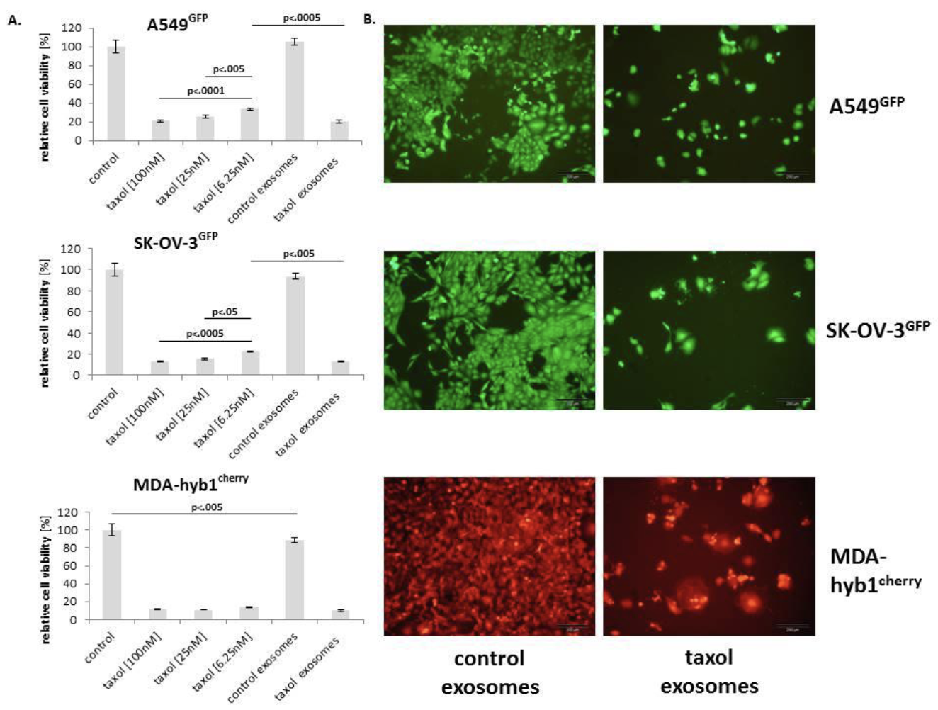
Therapeutic Response Assessment of Engineered Exosomes on a Panel of Cancer Cell Lines In Vitro
Relative chemotherapeutic response of different human cancer cell populations, including:
A549GFP lung cancer (upper panel),
SK-OV-3GFP ovarian cancer (middle panel),
MDA-hyb1cherry breast cancer (lower panel) cells
Catharina Melzer et al., “Taxol-Loaded MSC-Derived Exosomes Provide a Therapeutic Vehicle to Target Metastatic Breast Cancer and Other Carcinoma Cells”
Notes:
\

Slide 23
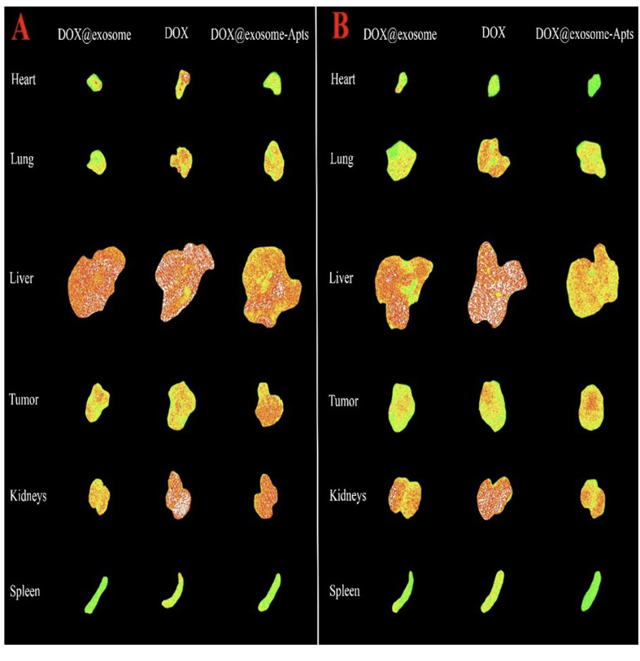
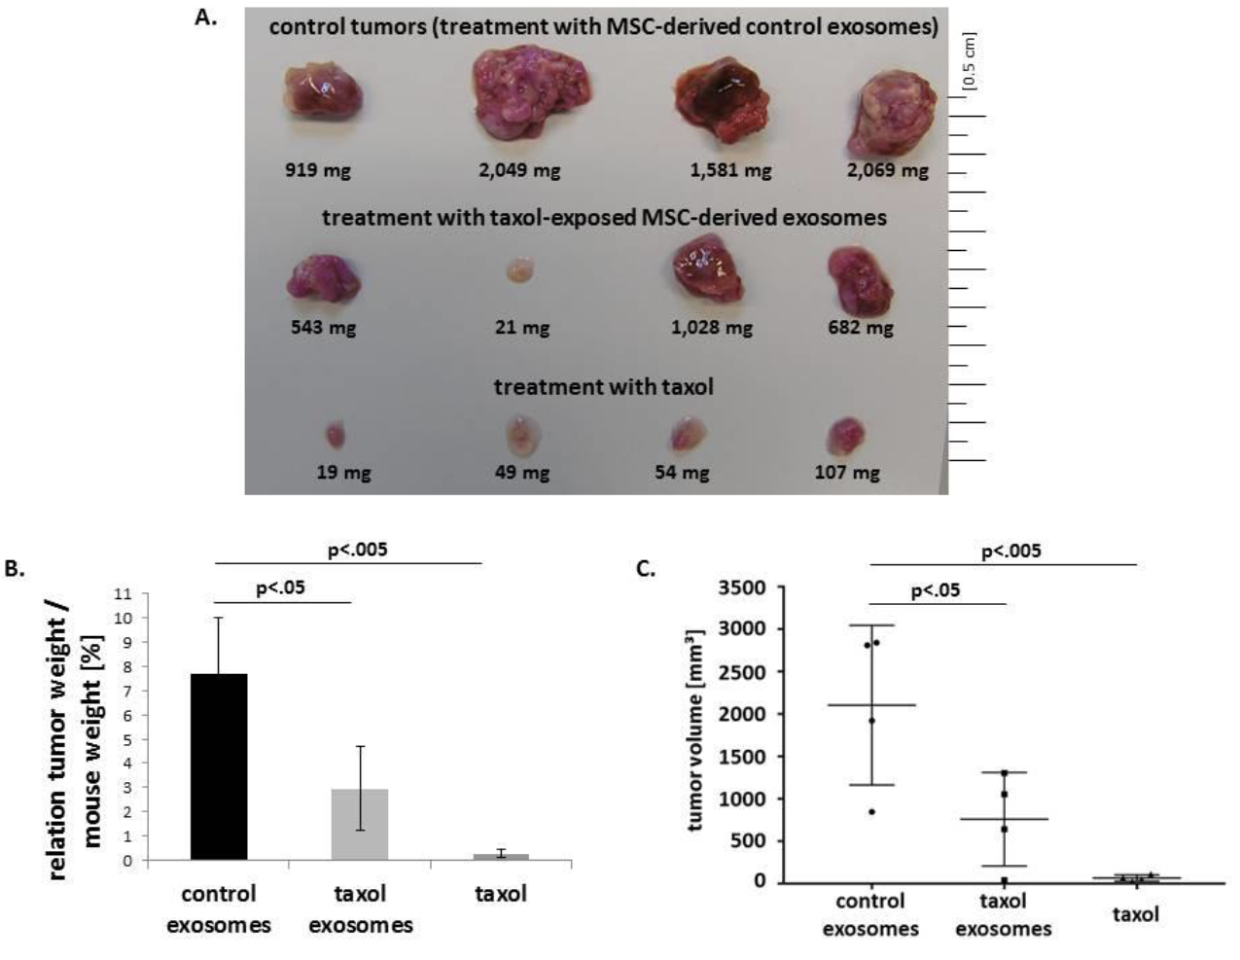
In Vivo Efficacy and Safety Evaluation
We anticipate a reduction in tumor volume and in metastasis when administering R848-loaded exosomes, at dosages lower than those used for free R848 injections
Fluorescence images of tumor, liver, spleen, kidneys, heart, and lungs of
tumor-bearing mouse models after 6h and 24h post injection
Elnaz Bagheri et al.,
Notes:
\

Slide 24
References
Turning cold tumors into hot tumors by improving T cell infiltration Yuan-Tong Liu, Zhi-Jun Sun doi: 10.7150/thno.58390
C. Peña-Romero and E. Orenes-Piñero, “Dual Effect of Immune Cells within Tumour Microenvironment: Pro- and Anti-Tumour Effects and Their Triggers,” Cancers, vol. 14, no. 7, p. 1681, 2022, doi: 10.3390/cancers14071681
Tong et al., “Tumor Associated Macrophages, as the Dominant Immune Cells, Are an Indispensable Target for Immunologically Cold Tumor—Glioma Therapy?,” Front. Cell Dev. Biol., vol. 9, p. 706286, 2021, doi: 10.3389/fcell.2021.706286
X. Shen et al., “TAM-targeted reeducation for enhanced cancer immunotherapy: Mechanism and recent progress,” Front. Oncol., vol. 12, p. 1034842, 2022, doi: 10.3389/fonc.2022.1034842
Jiachen Wen et al, “CSF1R inhibitors are emerging immunotherapeutic drugs for cancer treatment” - doi: 10.1016/j.ejmech.2022.114884 Elsevier - European Journal of Medicinal Chemistry
F. Peyraud and A. Italiano, “Combined PARP Inhibition and Immune Checkpoint Therapy in Solid Tumors,” Cancers, vol. 12, no. 6, p. 1502, 2020, doi: 10.3390/cancers12061502
Zhijie Weng et al. Therapeutic roles of mesenchymal stem cell-derive extracellular vesicles in cancer. Journal of Hematology & Oncology 2021 - doi: 10.1186/s13045- 021-01141-y
Cristiana Ulpiano et al., “Bioengineered Mesenchymal-Stromal-Cell-Derived Extracellular Vesicles as an Improved Drug Delivery System:Methods and Applications” - Biomedicines 2023 – doi: 10.3390/biomedicines11041231
Catharina Melzer et al., “Taxol-Loaded MSC-Derived Exosomes Provide a Therapeutic Vehicle to Target Metastatic Breast Cancer and Other Carcinoma Cells” - CANCERS 2019, doi: 10.3390/cancers11060798
Elnaz Bagheri et al., “Targeted doxorubicin-loaded mesenchymal stem cells-derived exosomes as a versatile platform for fighting against colorectal cancer” – Life Sciences 261 2020 – doi: 10.1016/j.lfs.2020.118369

